Slide 1
IMPLEMENTATION
OF ALTERNATION FUNCTIONS IN C++
FOR DETECTION AND EVALUATION
OF BIAS IN ML
Ilaria Pilo, s296847
Davide Porello, s295099
Marco Porro, s295654

Slide 2
01
INTRODUCTION
Project objective and observations

Slide 3
OBJECTIVE
The goal of the project is to implement the approach described in the Detection and Evaluation of Machine Learning Bias research paper applying C++ parallelization techniques,
and measure their performance.

Slide 4
PRELIMINARY OBSERVATIONS
The paper omits essential details needed for its replication. Specifically:
There is not a precise description of the preprocessing steps performed on the dataset.
Unlike what stated in the paper, the alternation function must NOT be computed on an entire dataset, but only on the test set of the K-fold algorithm.
The Census-Income Dataset contains mainly categorical features. For this reason, a polynomial regression algorithm is not the best choice to solve this problem.

Slide 5
02
DESIGN
Project structure
and implementation choices

Slide 6
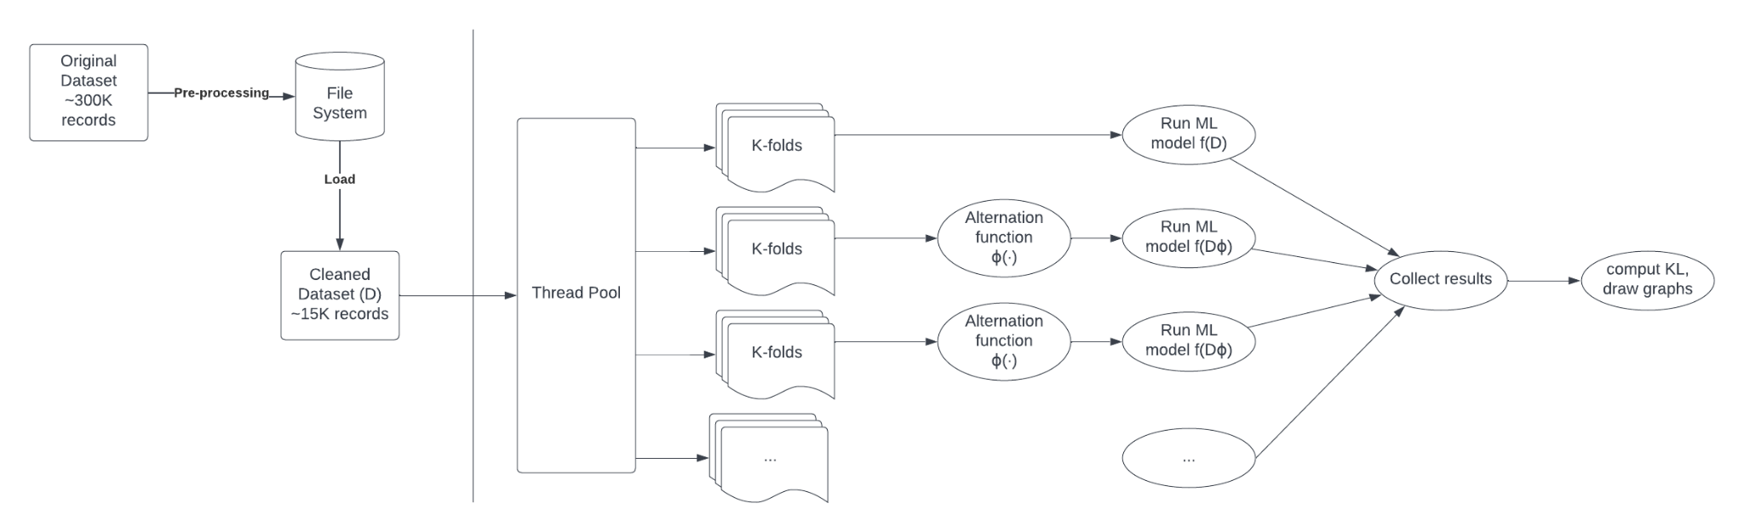
PROJECT STRUCTURE
We split the workflow of the application in three main parts: pre-processing (sequential),
k-fold (concurrent, one task in the thread pool for each fold) and post-processing (sequential).

Slide 7
03
RESULTS

Slide 8
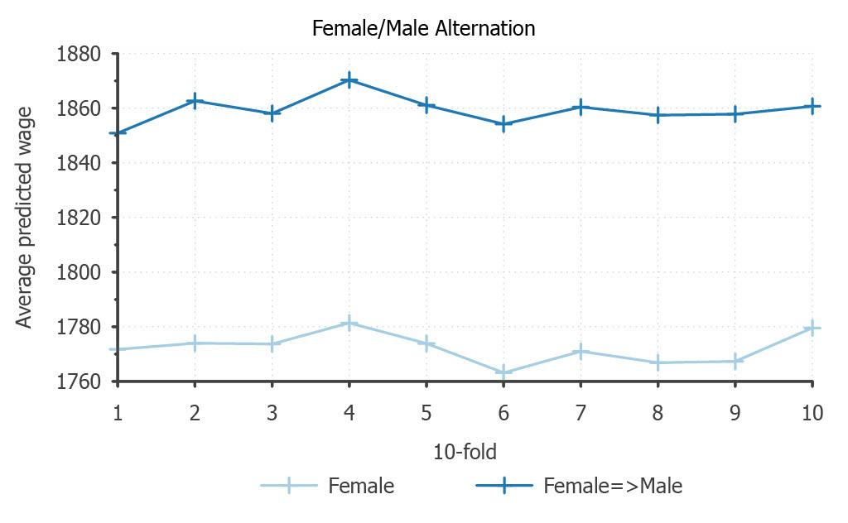
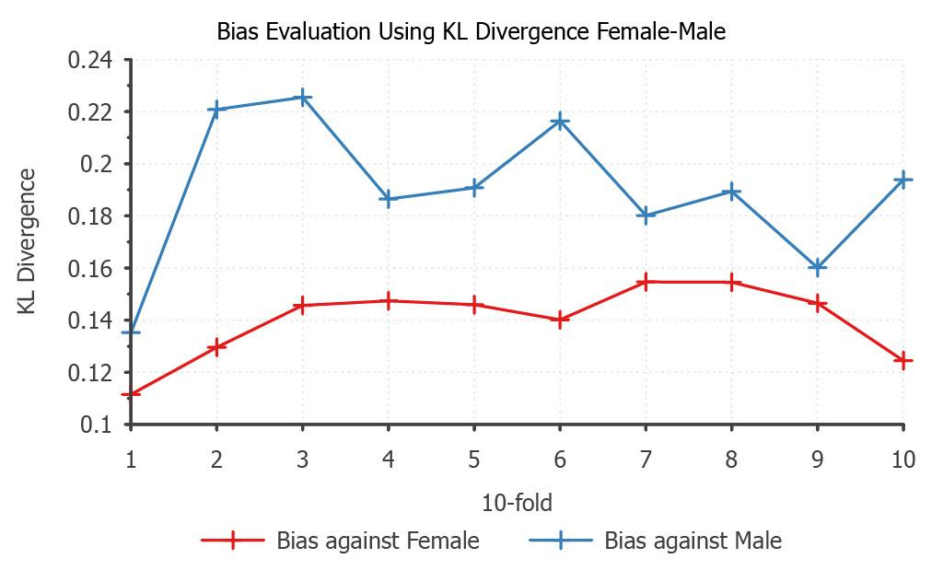
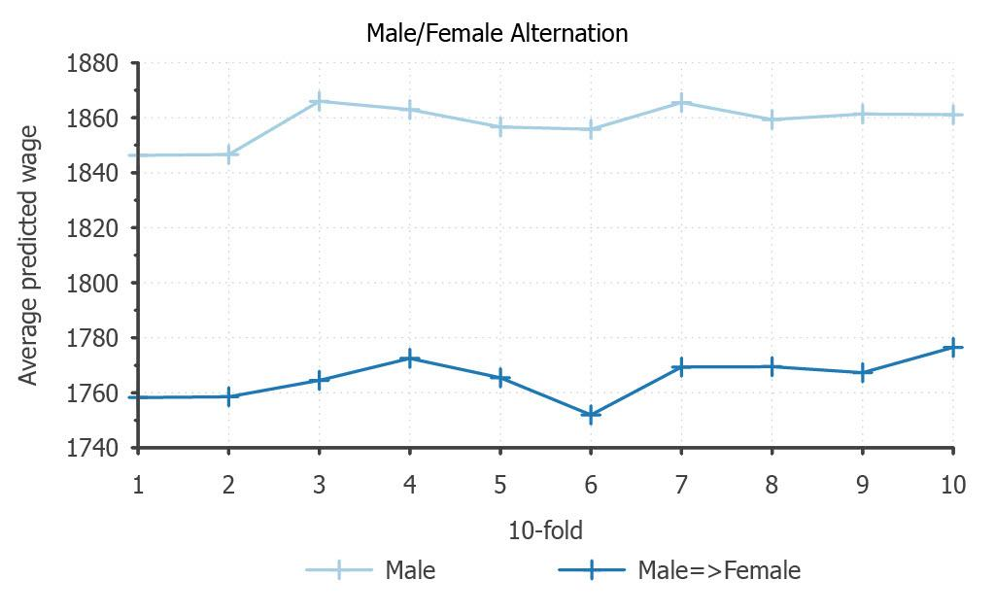
BIAS EVALUATION - GENDER - POLYNOMIAL REGRESSION
The alternation plots clearly show a bias in favour of males.

Slide 9
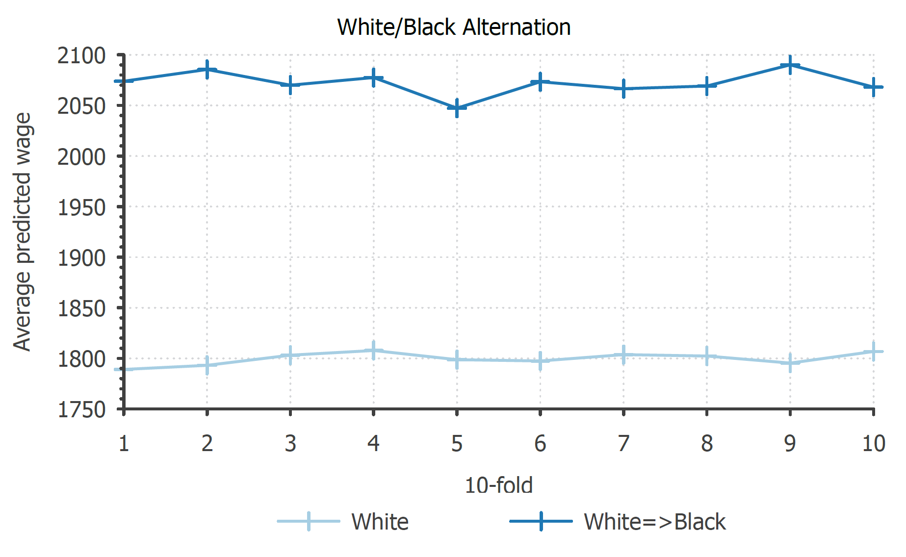
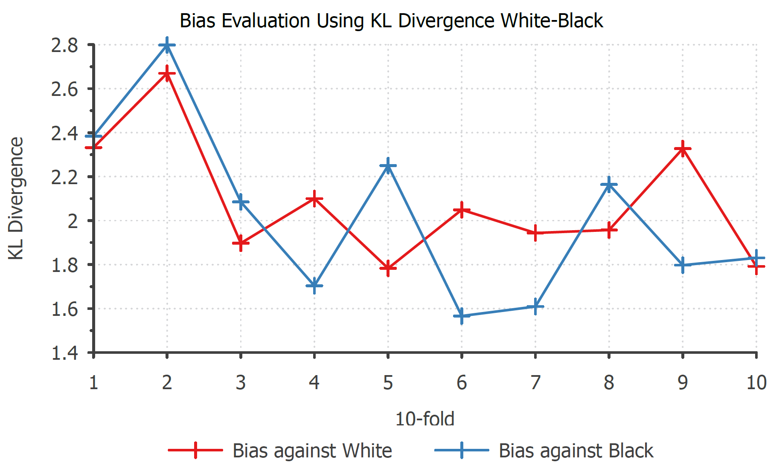
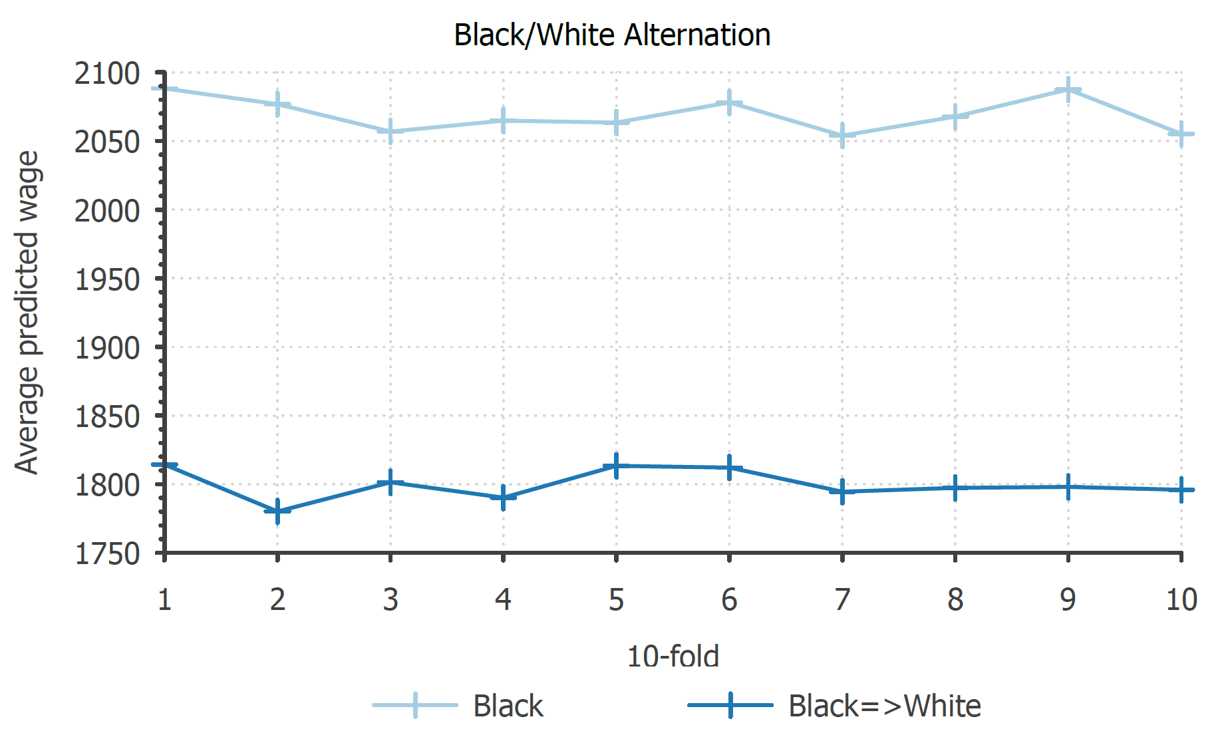
BIAS EVALUATION - RACE- POLYNOMIAL REGRESSION
The alternation plots clearly show a bias in favour of black people.
As in the paper, the KL divergences are comparable.

Slide 10
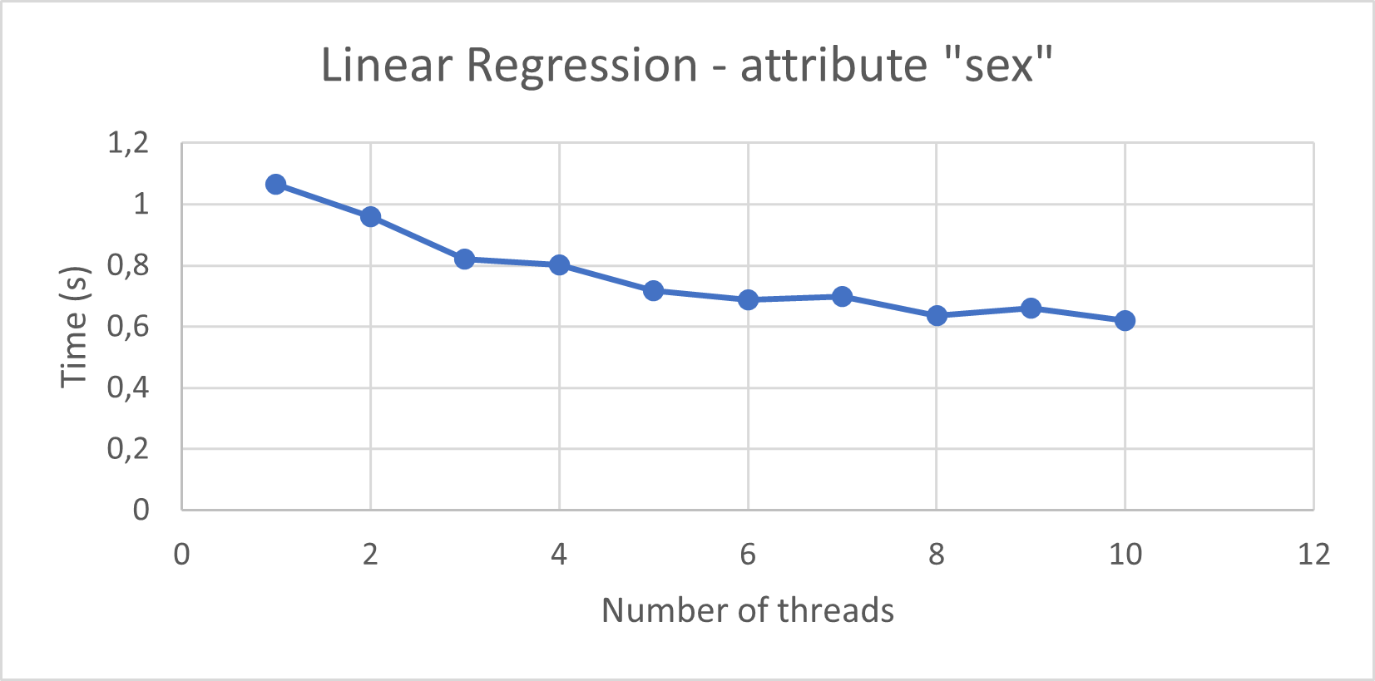
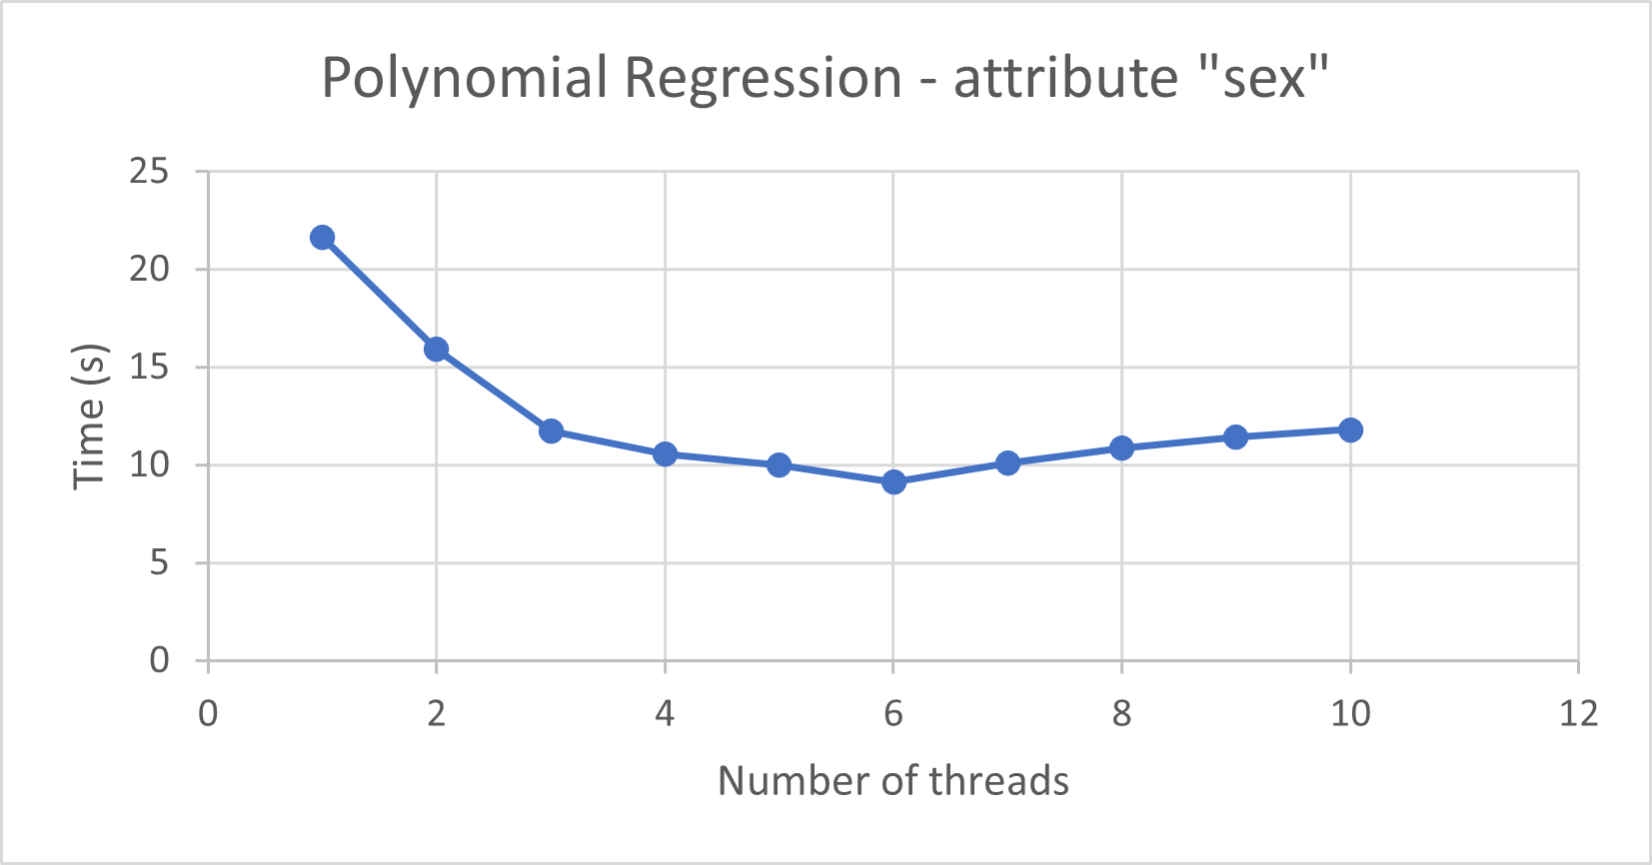
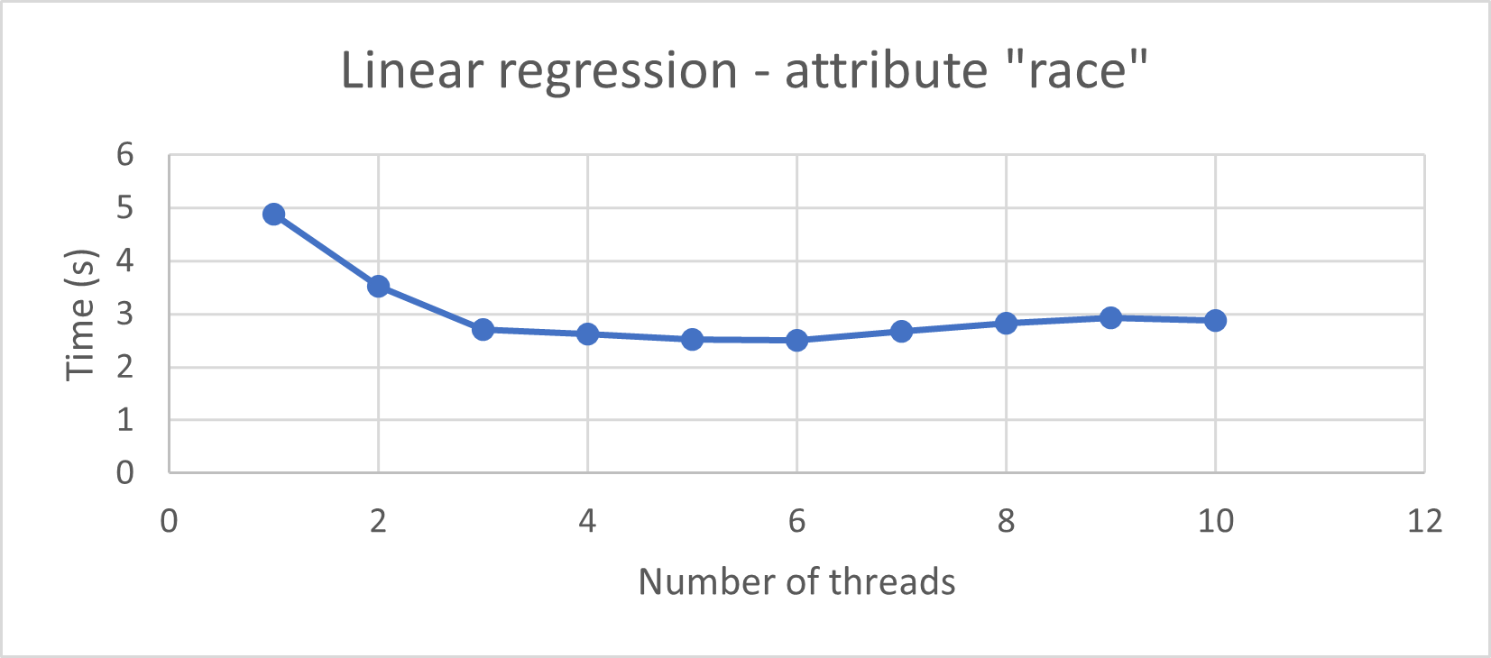
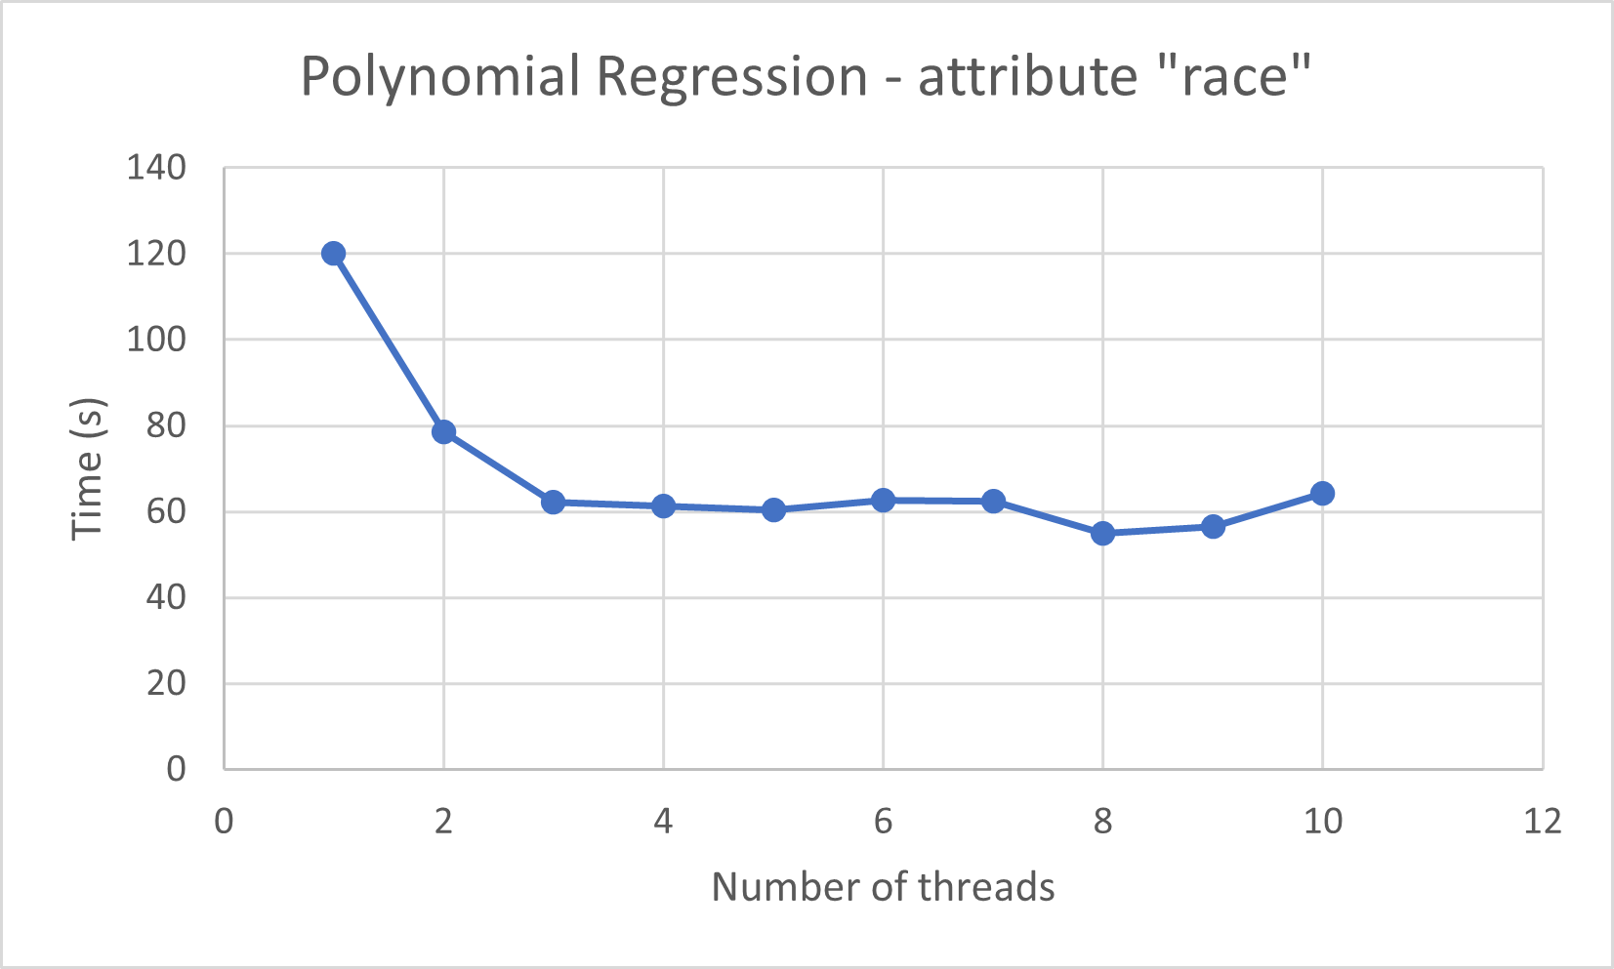
PERFORMANCE
Benchmarks collected on a machine with N=4 hardware threads.
The best performance is recorded when using N threads or more in the thread pool.

Slide 11
ADDITIONAL PERFORMANCE METRICS
ALTERNATION FUNCTION
KL DIVERGENCE
The alternation function is very inexpensive (< 1ms), and it is called max 1 time in each thread.
As such, it does not need internal parallelization.
Additionally, the code already uses the maximum effective number of threads, so adding more does not increase the performance.
As the alternation function, it requires <1ms.
The computation of the mean and variance is performed inside the threads of the thread pool.

